Slide 1
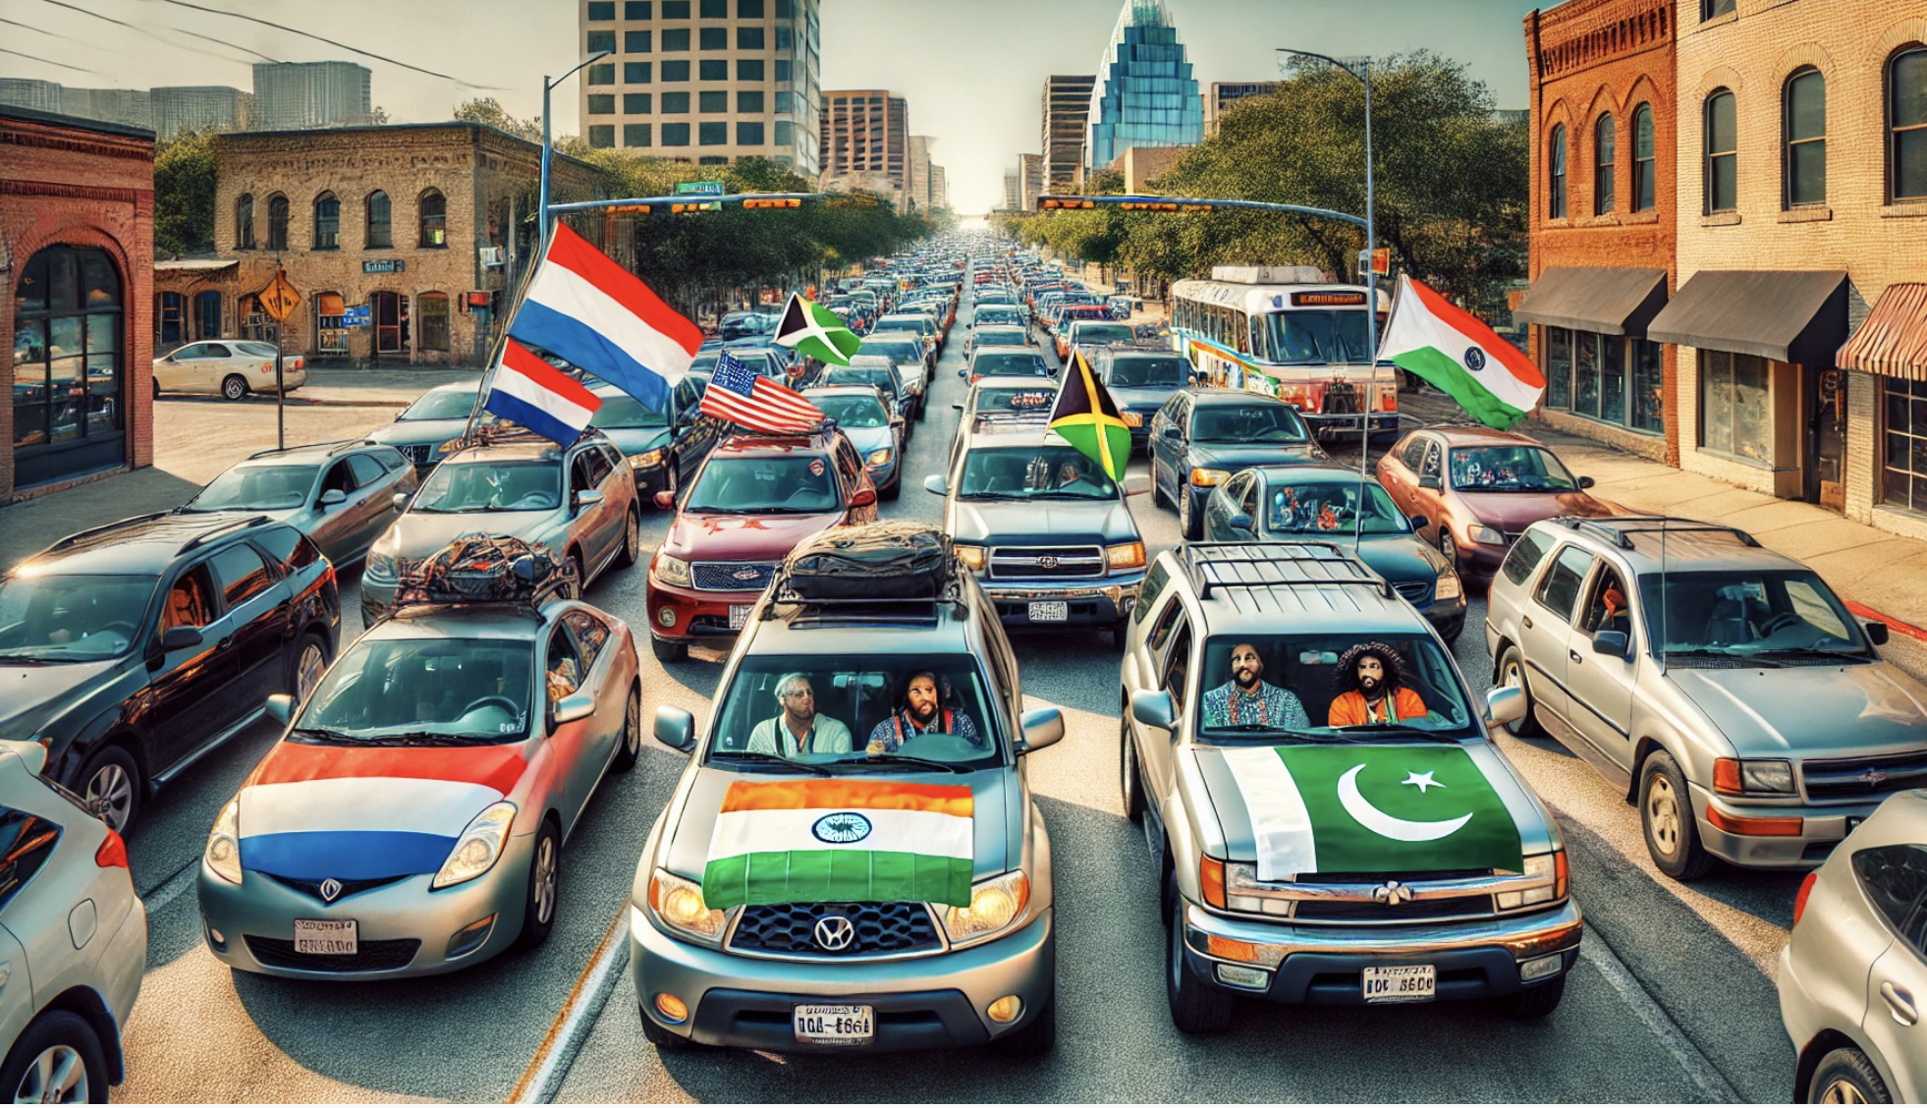

Slide 2
Texas Traffic
Sushanth Ravichandran
Muhammad Ibrahim
Kimberly Simmonds
Femke Munting
Shashank Rao
Mason Shu

Slide 3
54 Hours in Traffic
3500 Accident Per Day
$13.7 Billion in Damages
PROBLEM STATEMENT: Predict the duration of traffic delays following an accident in the state of Texas
Notes:
Add citations

Slide 4
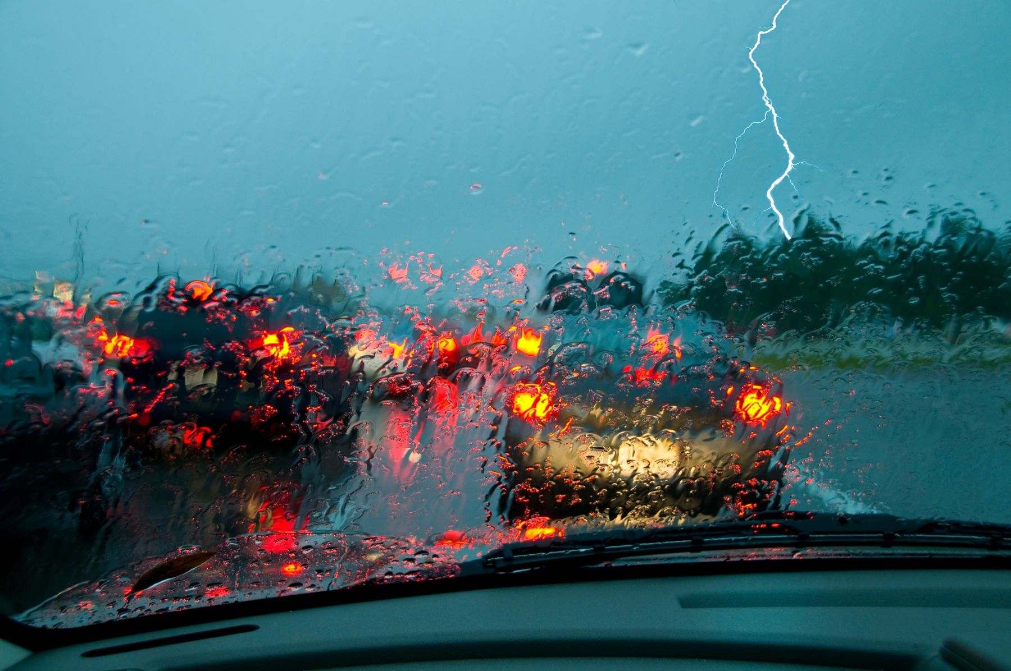
Dataset Overview
US Accidents (2016 - 2023)
All 50 states ~7.7. million rows
Texas ~38k rows
Variables classes
Geographic
Weather
Road Conditions
Notes:
Images; Rule of 3: Tittle - 50 states 7.7M , subsetting - Texas 37K rows ; years

Slide 5
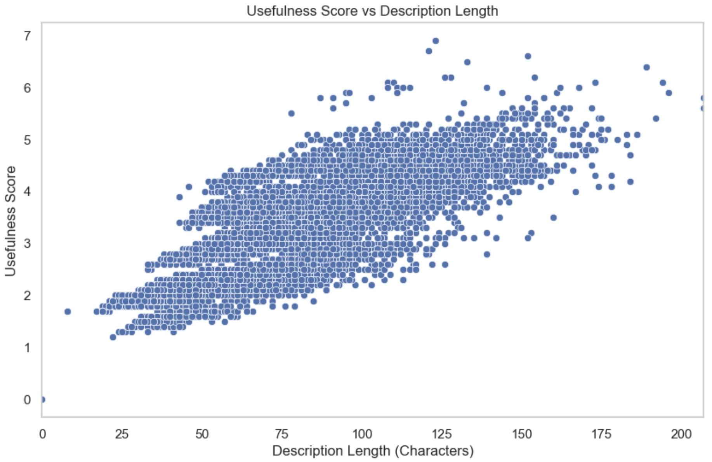
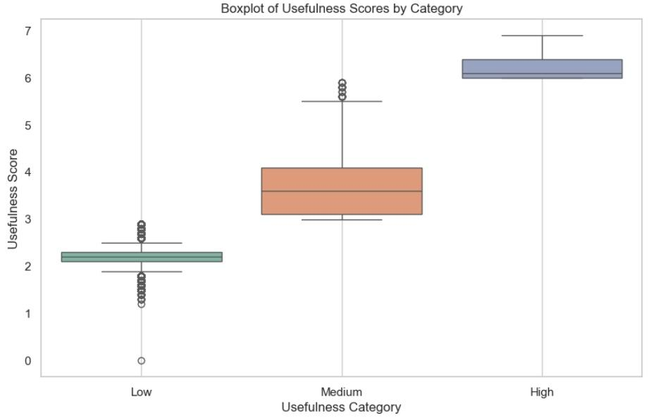
Natural Language Processing
Description column processed to obtain a usefulness score
Length - Longer descriptions generally provide more detailed information
Key Terms - Descriptions that include terms related to traffic incidents score higher
Clarity - Higher number of unique words suggests more varied information

Slide 6
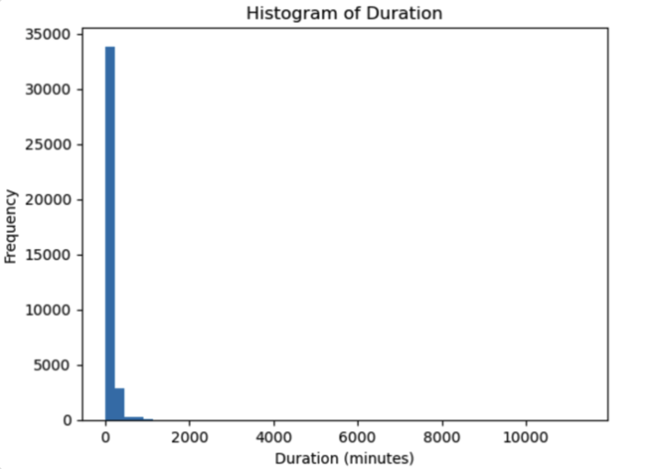
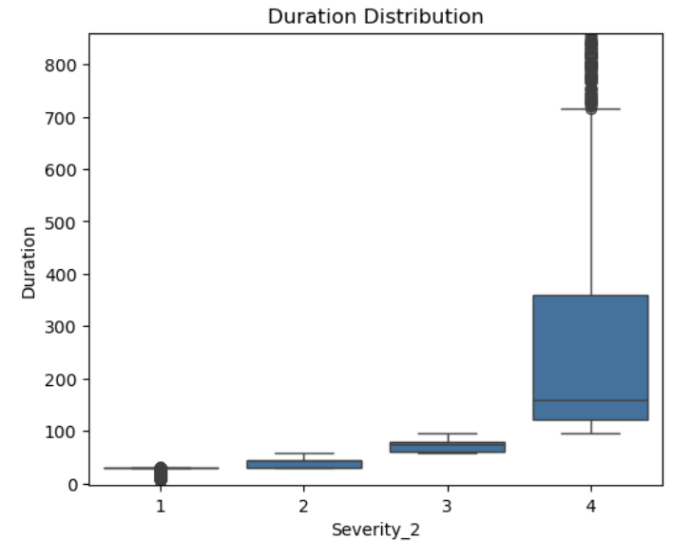
Duration and Severity
Severity | count | min | max | mean | median
1 | 9362 | 6 | 29 | 28.61 | 29.600
2 | 9315 | 29 | 57 | 39.92 | 44.500
3 | 9425 | 58 | 96 | 73.02 | 75.000
4 | 9222 | 96 | 11359 | 244.29 | 159.025
Duration is our target variable and is measured in minutes
Notes:
Year vs Severity2 - Shashank ; Duration + Severity & Boxplot - Ibrahim

Slide 7
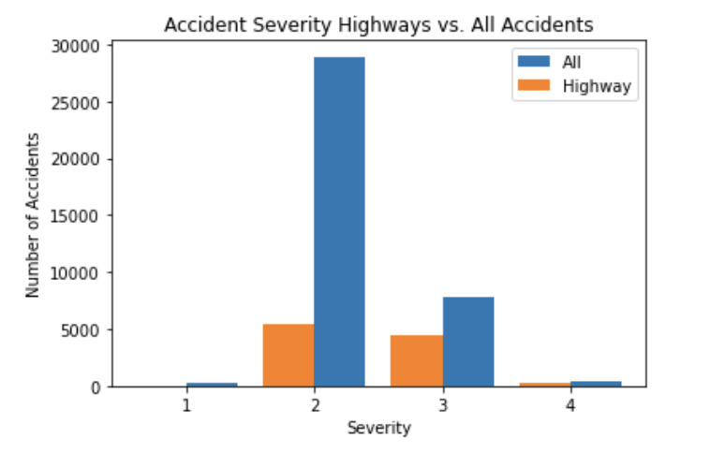
Highway vs. Total Dataset
Notes:
FEMKE: Should we replace this with a histogram of accident duration w/ highway vs. all split?

Slide 8
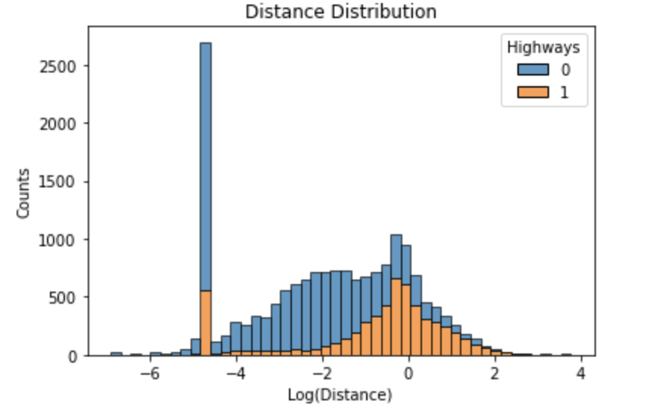
Distance Distribution
Notes:
Distance:
Max = 43.25
Median = 0.0
Mean = 0.28
20,303 samples w/ distance 0.0 (lots didn’t have End Lat/Lng
Hist is missing 0 (can’t log 0)

Slide 9
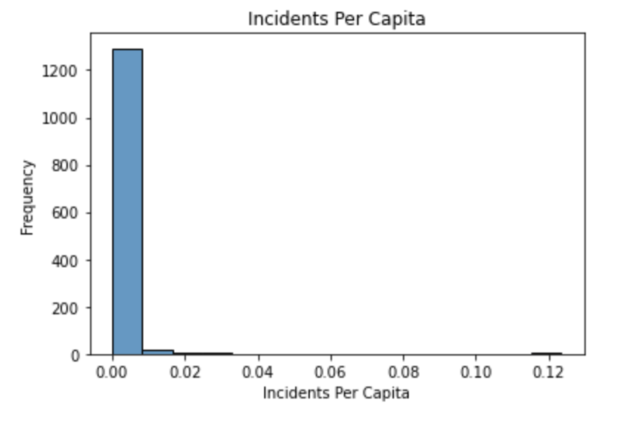
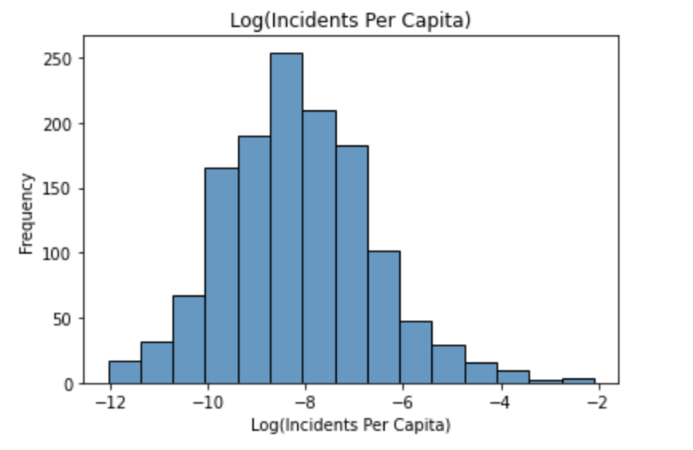
Geographic
Number of cities
Traffic incidents/ capita?
New variables (web scraping)
Per Capita Incident Rate
Population/ city

Slide 10
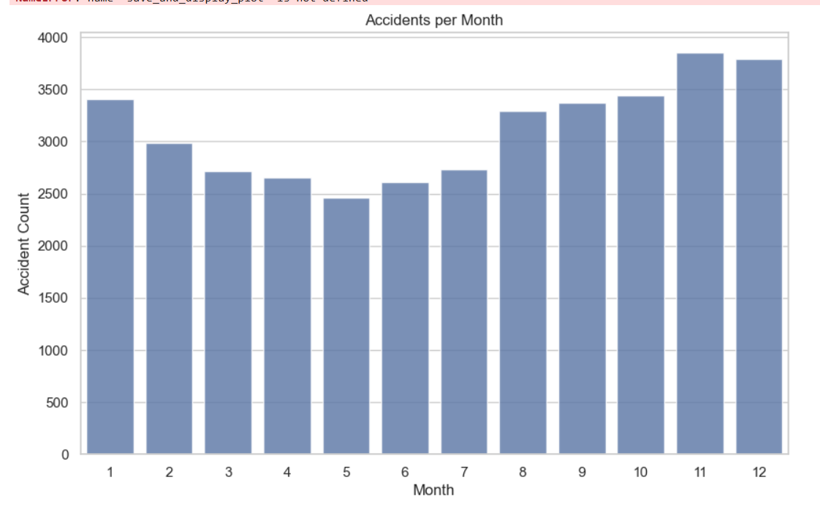
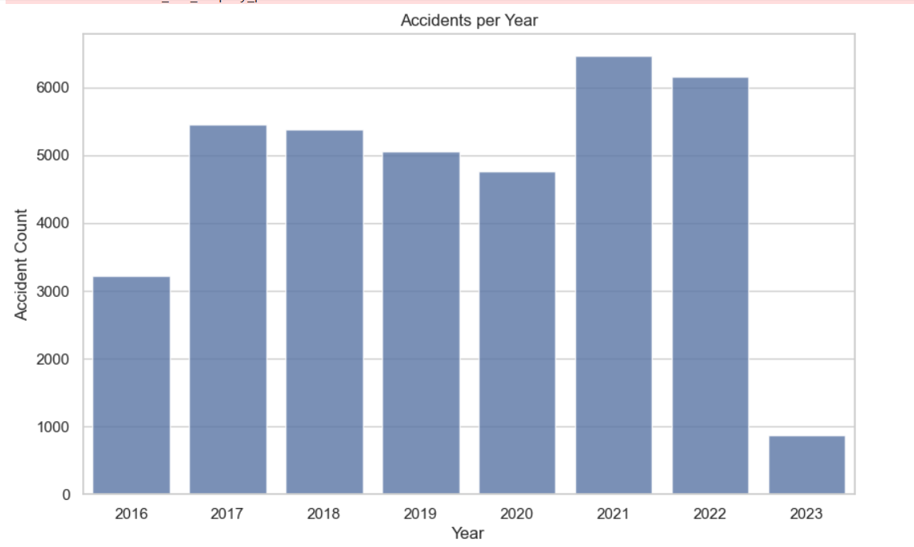
Accident Statistics
Notes:
->Winter Months have more number of accidents than normal ->for this particular dataset, years 2016 and 2023 are not complete ->we can see that there was a dip in 2020 , but the reason i guess we will never know

Slide 11
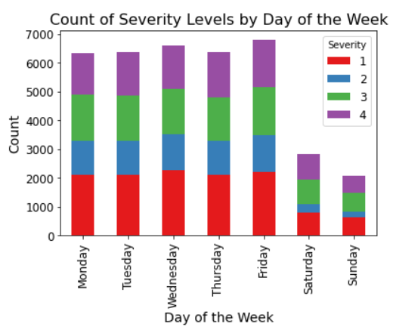
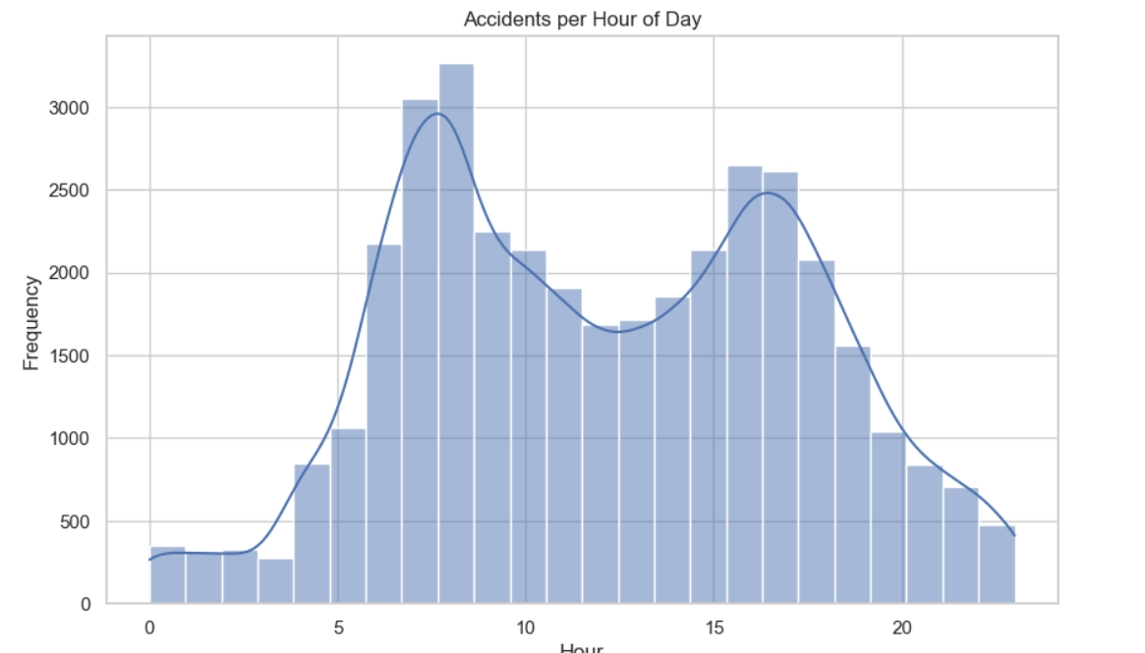
Accident Timing
Notes:
Day of the week- For this we can see that Saturdays and sundays have the least number of accidents
Hour of the Day- We can see that the during the peak hours of 9 am and 5 am we have a lot of accidents happening
And if you are planning to get to school at this time..welll that’s you cue

Slide 12
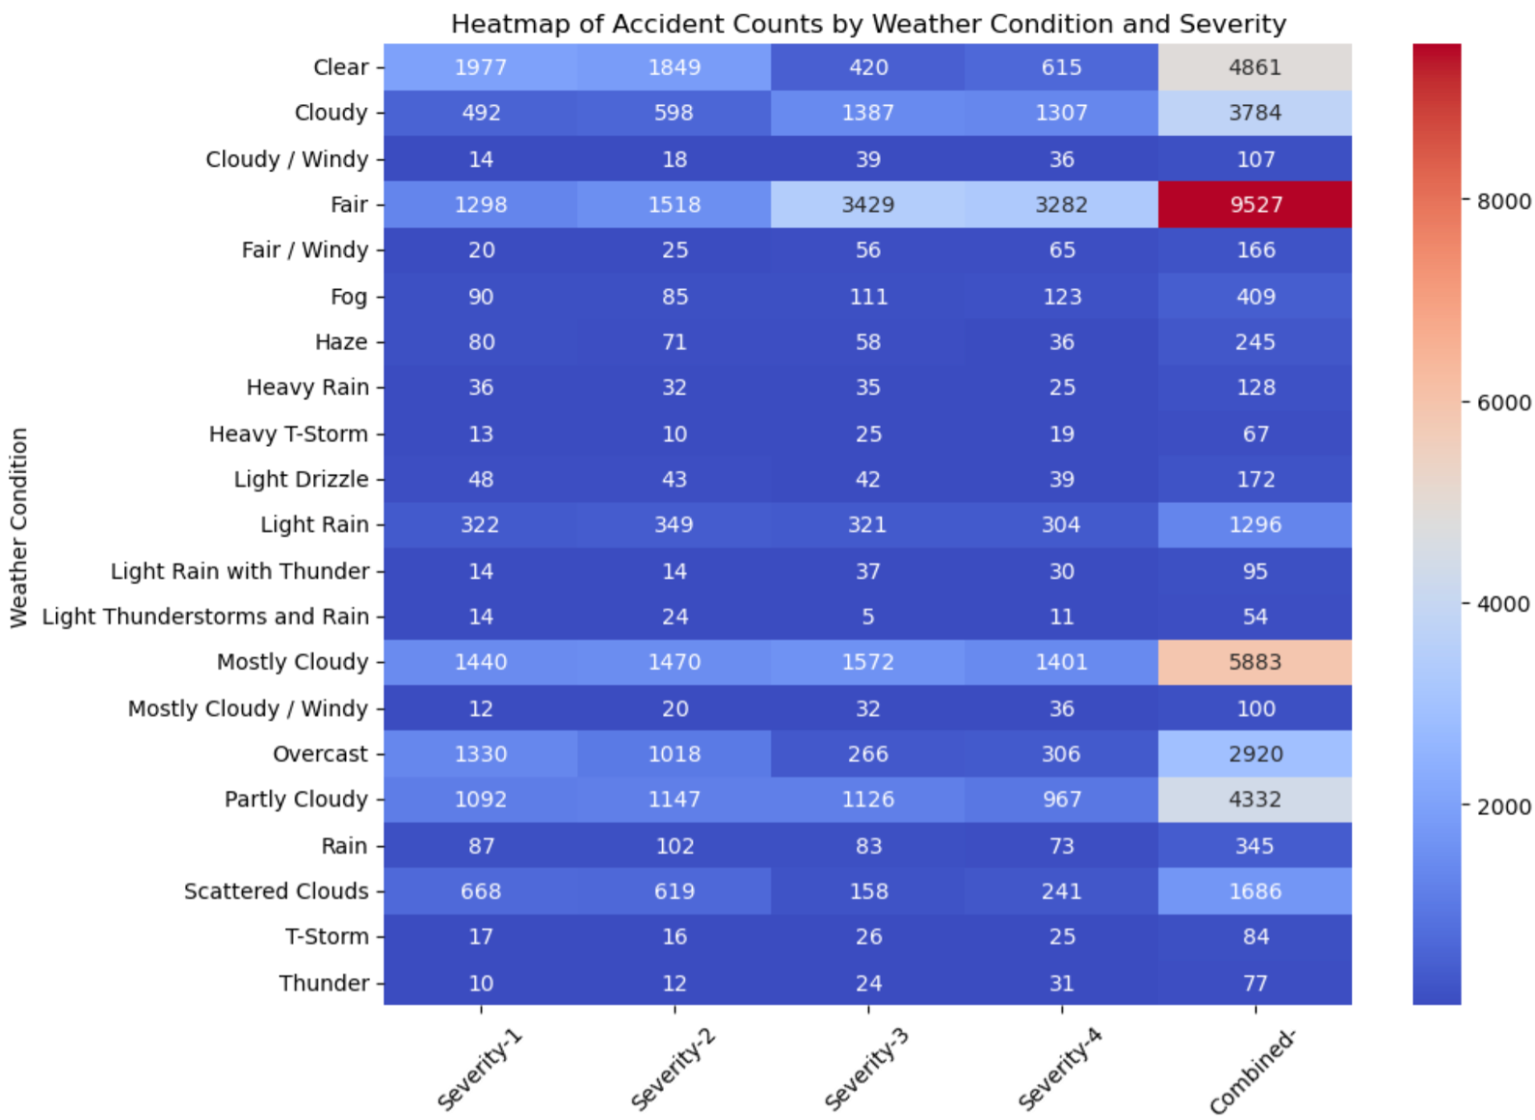
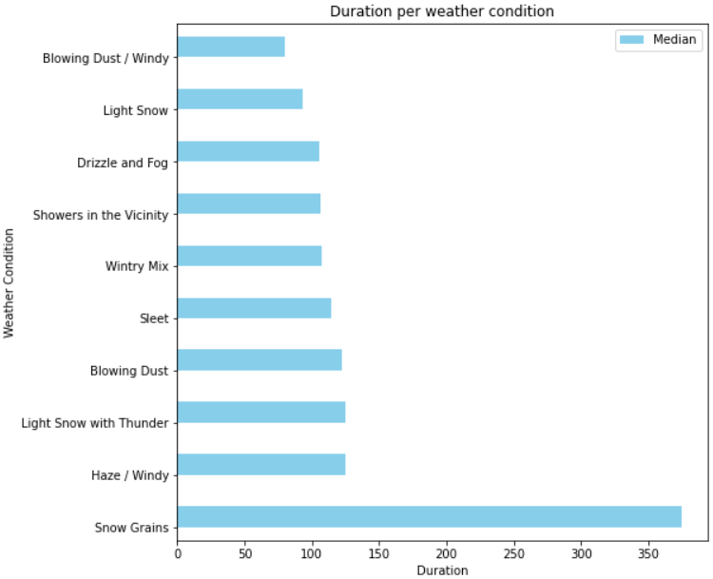
Weather Conditions
Notes:
We can see that “Fair” weather condition has most accidents but that could also mean the weather is fair most of the time.
But what’s interesting here is when we have rain or slight rain we have higher number of accidents
For the weather conditions - we have plotted for the top 10 weather conditions the probability you getting stuck in traffic is high when the weather is snowy of dusty

Slide 13
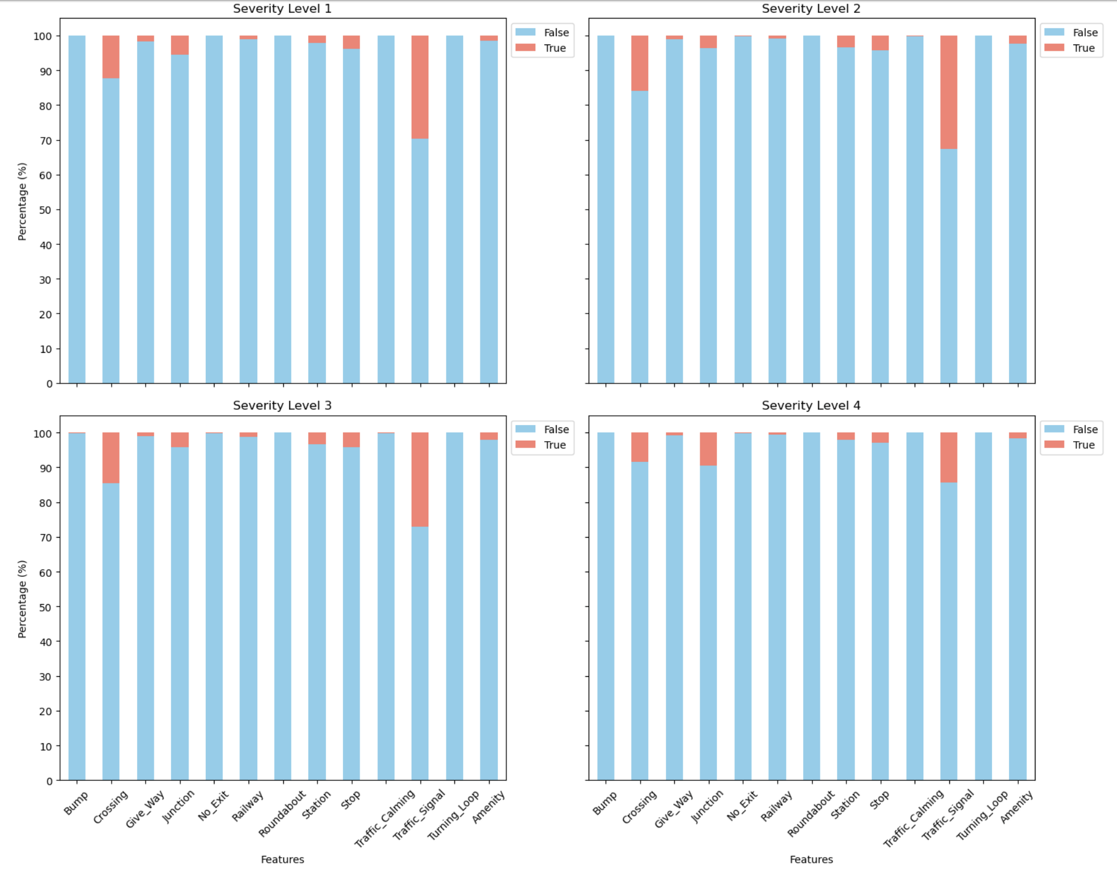
Road Conditions
On average:
10% of accidents occur near a crossing
30% of accidents happen near a traffic signal
Almost nobody gets into an accident next to a bump in the road!
Notes:
We can see that road conditions barely make any impact on sev 4 accidents.

Slide 14
Modeling Structure
Train: 2017 - 2022 Test: 2023 ~50 features
Approaches to Target variable skew:
No treatment of skew
Transform values above 80th percentile
Remove skew values
80th percentile ~ 120 minutes.
Models:
Random Forest
Bagging Tree
XGBoost
Decision Tree
BART
Clustering

Slide 15
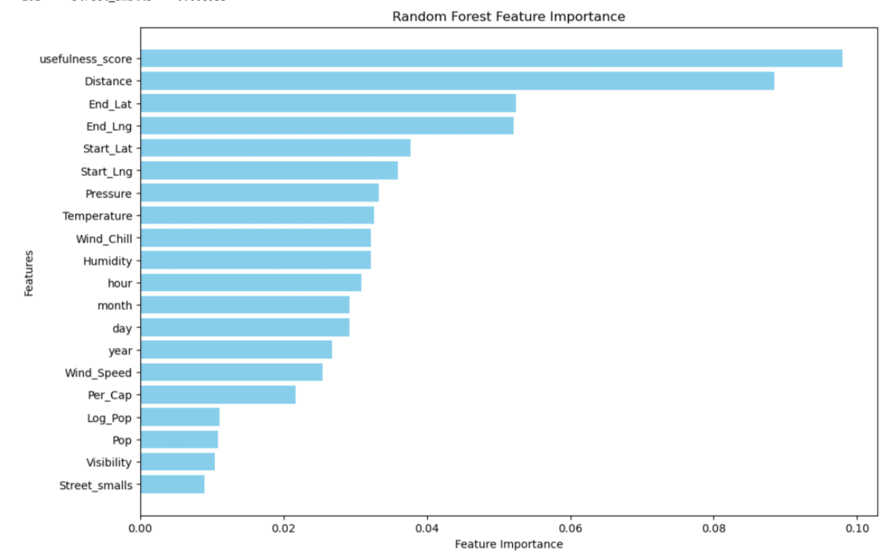
Model: Random Forest / Bagging Tree
Pre-processing:
Smalls for <10 obs
One-hot encoding
CV results:
Ntree = 1000
Max variables = 30
Max variables for Bagging = None
Test Results (RMSE):
RF = 30.98
Bagging = 23.20

Slide 16
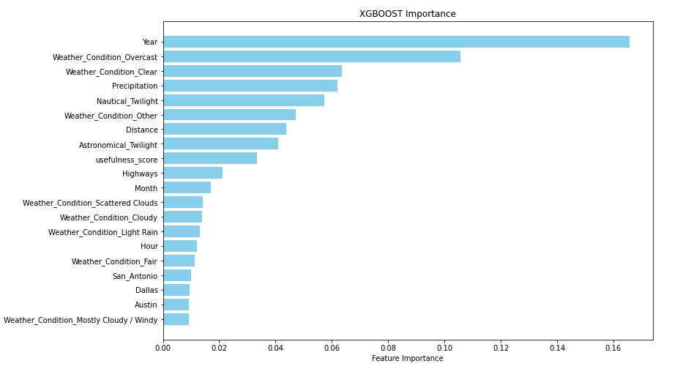
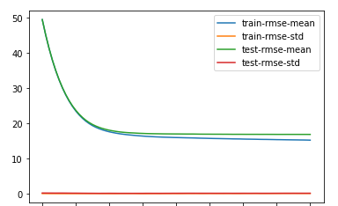
Model: XGBoost with Gridsearch
Pre-processing:
Smalls for <10 obs
One-hot encoding
CV results:
Learning rate/shrinkage = 0.1
Max tree depth = 5
Number of trees = 150
Test Results (RMSE):
27.06

Slide 17
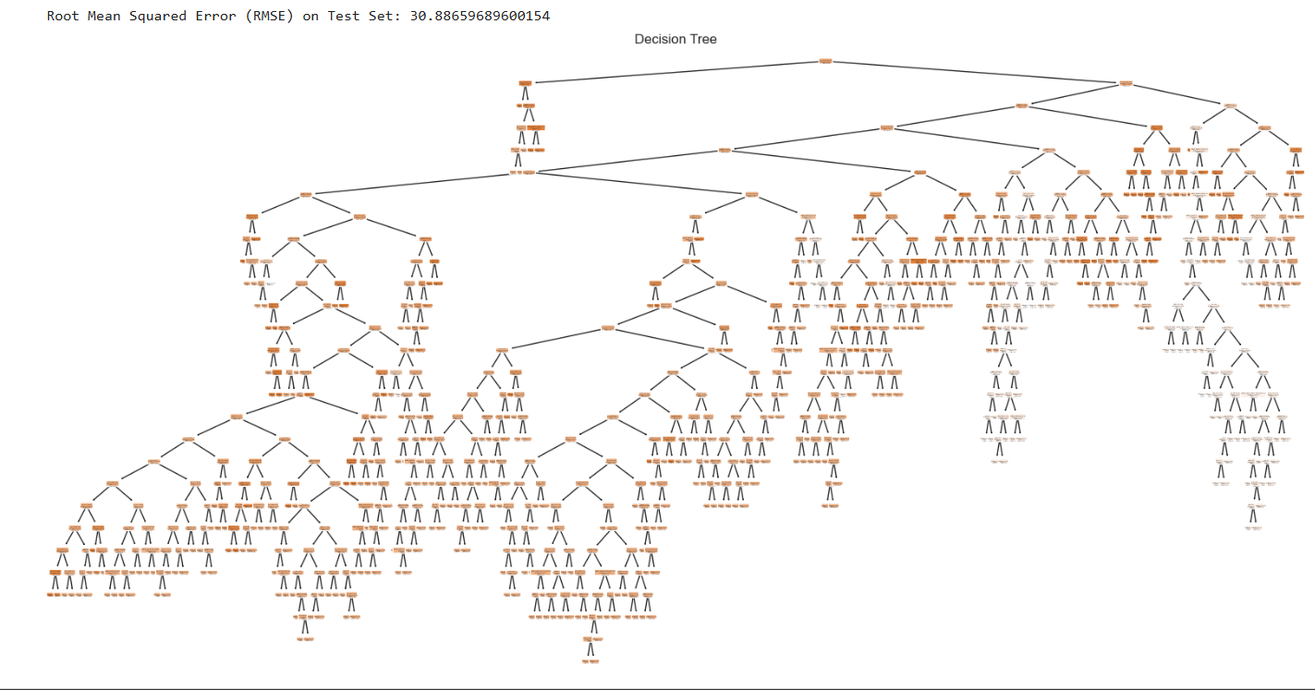
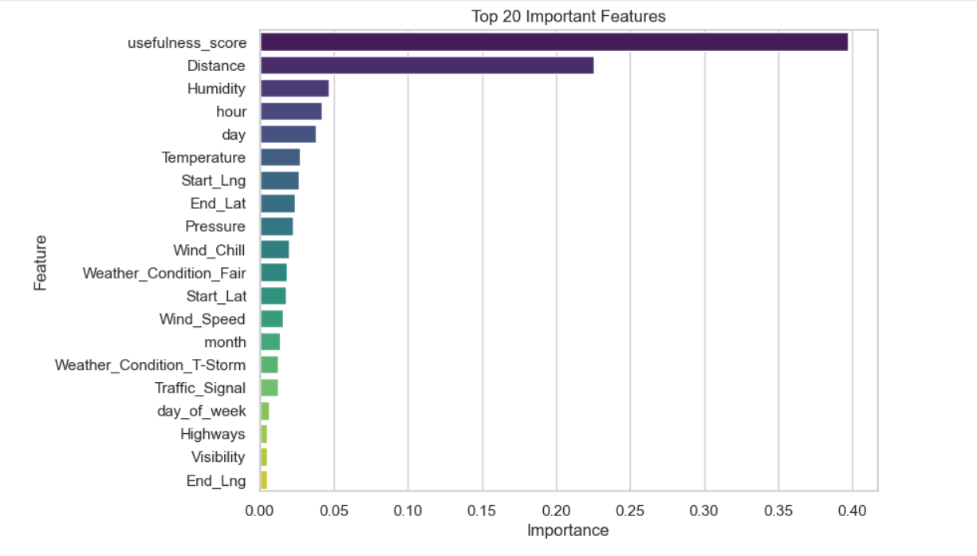
Decision Trees

Slide 18
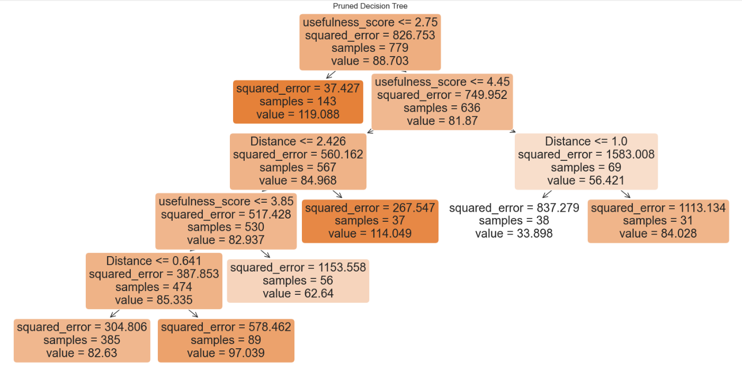
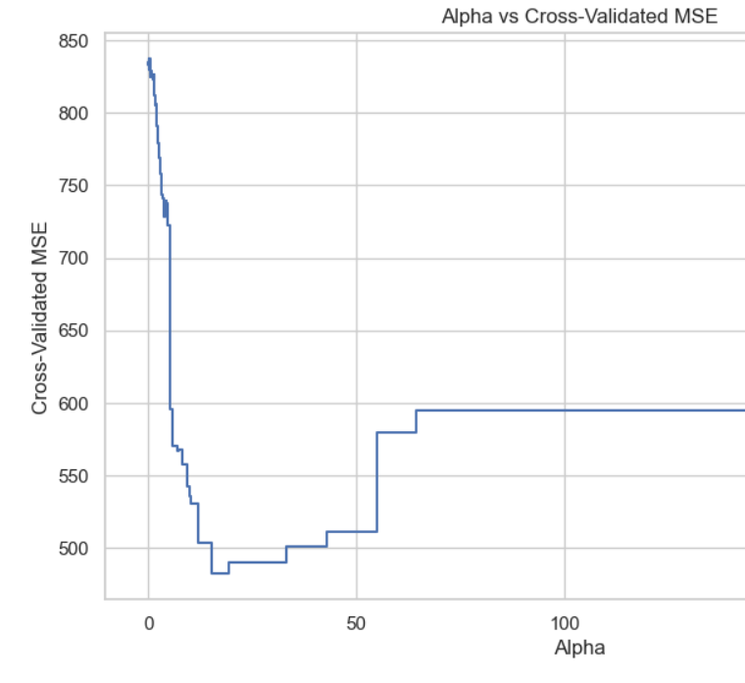
Pruned Decision Tree
Root Mean Squared Error (RMSE) on Test Set: 30.88 on a full grown tree
Best alpha: 15.25
Root Mean Squared Error (RMSE) of Pruned Tree on Test Set: 22.93

Slide 19
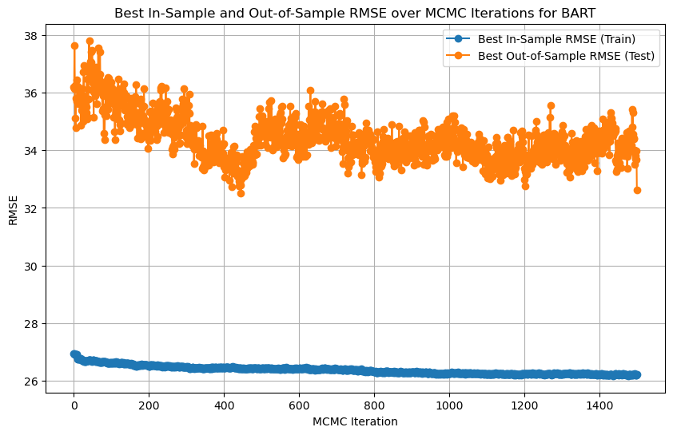
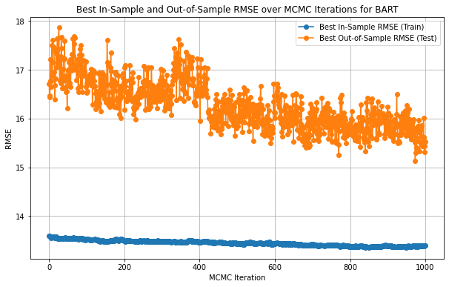
Model: BART Regression
Industry Model: Duration capped at 120
Final Best In-Sample RMSE: 26.2266
Final Best Out-of-Sample RMSE: 32.6228
Ideal Model: Duration <= 120
Final Best In-Sample RMSE: 18.8156
Final Best Out-of-Sample RMSE: 26.1102
Best Model: Duration <= 90
Final Best In-Sample RMSE: 13.3920
Final Best Out-of-Sample RMSE: 15.5299
Notes:
BART (Bayesian Additive Regression Trees) is an ensemble model where the predictions of multiple decision trees are summed and averaged to model f(x). The sampling process uses MCMC, which takes thousands of iterations to make predictions.
BART performs worse than single tree - BART uses MCMC (Markov chain Monte Carlo) to sample from the posterior distribution of models, which introduces variability and can lead to less stable predictions compared to a deterministic single tree, and less likely to overfit
Best Model
Final Best In-Sample RMSE: 13.392011433169051
Final Best Out-of-Sample RMSE: 15.529926144939132
Best RMSE: 15.529926144939132 with parameters ntree=200, ndpost=1000, nskip=500 - RMSE might be high due to the high number of features and noise
ensemble model that averages over many trees
BART performs worse than single tree - BART uses MCMC (Markov chain Monte Carlo) to sample from the posterior distribution of models, which introduces variability and can lead to less stable predictions compared to a deterministic single tree, and less likely to overfit
BART uses a sum of the predictions of multiple decision trees to model f(x)

Slide 20
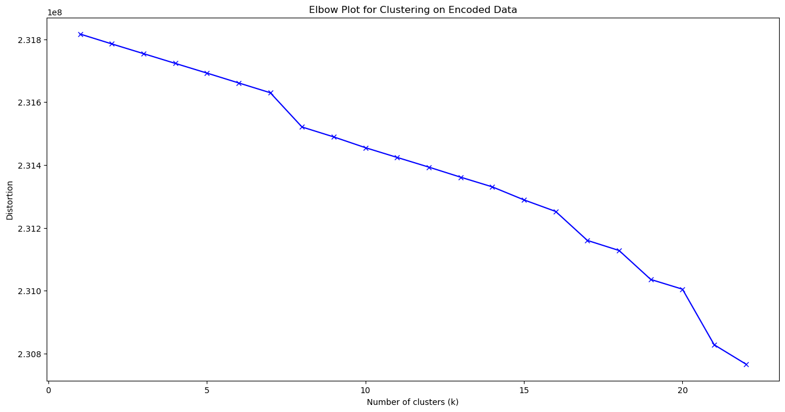
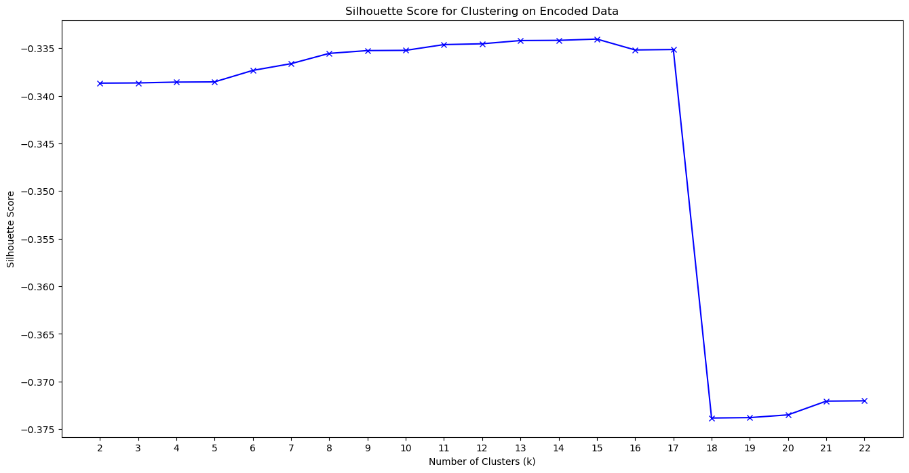
Model: Clustering
Elbow Plot
Silhouette Score
Notes:
Clustering is a model that uses unsupervised learning that involves determining natural groupings through “clustering” similar data points. Despite scaling our data, we could not the highest quality clusters due to the immense dimensionality of our dataset, with over 700 predictors after one-hot encoding.
From CLUSTER_2 to CLUSTER_6, the first two data points remain in the same cluster (e.g., Cluster 1), which indicates stability in these clusters as the number of clusters increases.
Scaled the data

Slide 21
Model Results
Model | All Data RMSE | Industry Model RMSE | Ideal Model RMSE
Decision Tree | 256.08 | 30.21 | 22.93
Bagging | 206.76 | 20.38 | 17.10
Random Forest | 247.76 | 30.98 | 20.45
XGBoost | 246.58 | 27.06 | 17.13
BART | 252.78 | 32.62 | 26.11
All Data: No treatment for skew.
Industry Model: Feature set skew control through upper cap at Duration value 120 minutes.
Ideal Model: Feature set trimmed by keeping data only till 120 minutes.
Notes:
Cropped out values above 120 because that was the 80th percentile

Slide 22
Conclusion and Key Takeaways
NLP Usefulness Score: Applying NLP to the description field provided a usefulness score, which improved the predictive power of our models. Listen to the radio!
Prediction Accuracy: Our best model, Bagging, achieved an RMSE of 20.38 minutes
Feature Importance: Key predictors included weather conditions, distance, precipitation, and whether the accident occurred on a highway
Time of Day: Peak traffic hours were found to have a higher frequency of accidents, leading to longer delays.

